Slide 1
“The creative industries continue to be dominated by those from privileged backgrounds. Less than one in ten arts workers comes from lower socio-economic groups. That’s not just a diversity issue, that’s a creativity crisis, and it means that we’re missing out on powerful radical and essential perspectives.”
Chris Sonnex, Big Issue, Issue 1666.

Slide 2

Analysis Delivering D&I
July 2025

Slide 3

BAE Systems D&I
Our ambition is to be recognised as the leading employer in the defence and security sectors for valuing diversity, equity and inclusion.
Plan to ensure that women make up at least 50% of our Executive Committee by 2030.
Increase representation of race, ethnicity, and gender in our workforce.
In the UK and by 2030 at the latest, our ambition is that more than 30% of our workforce will be women.

Slide 4
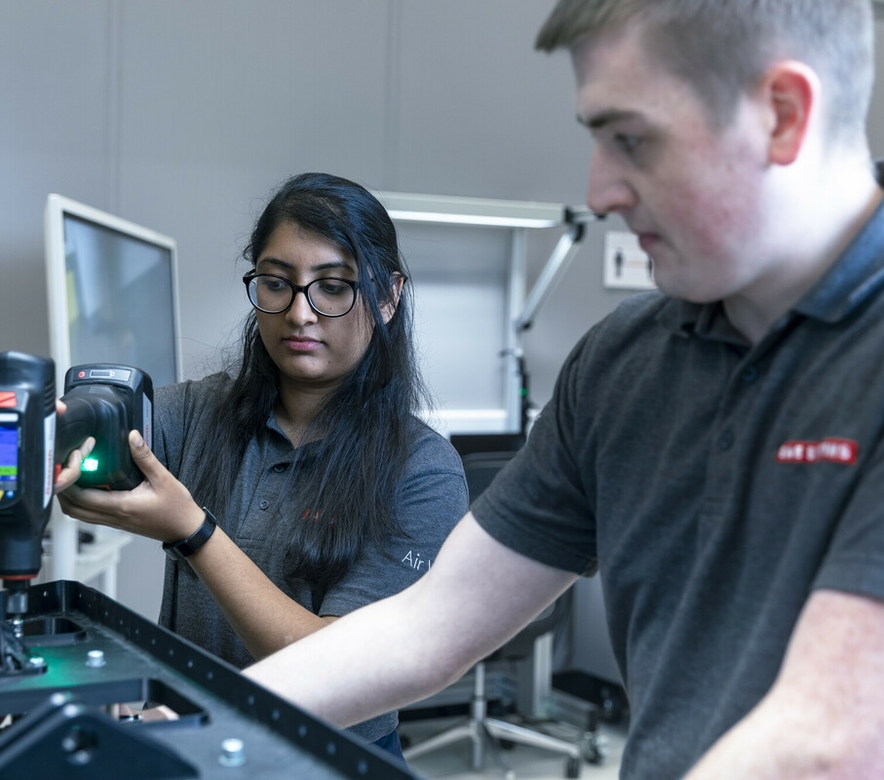
Background
There is a recognition of the need for diversity in the defence community – currently dominated by a fairly narrow demographic.
23%
Share of women in all positions
16%
Share of women in management positions in revenue generating functions
15%
Share of women in STEM related positions
Figures published by BAE Systems 2023

Slide 5
Observations
Greatest diversity is in our early careers community.
23%
Share of women in all positions
36%
Share of women in Future Talent

Slide 6
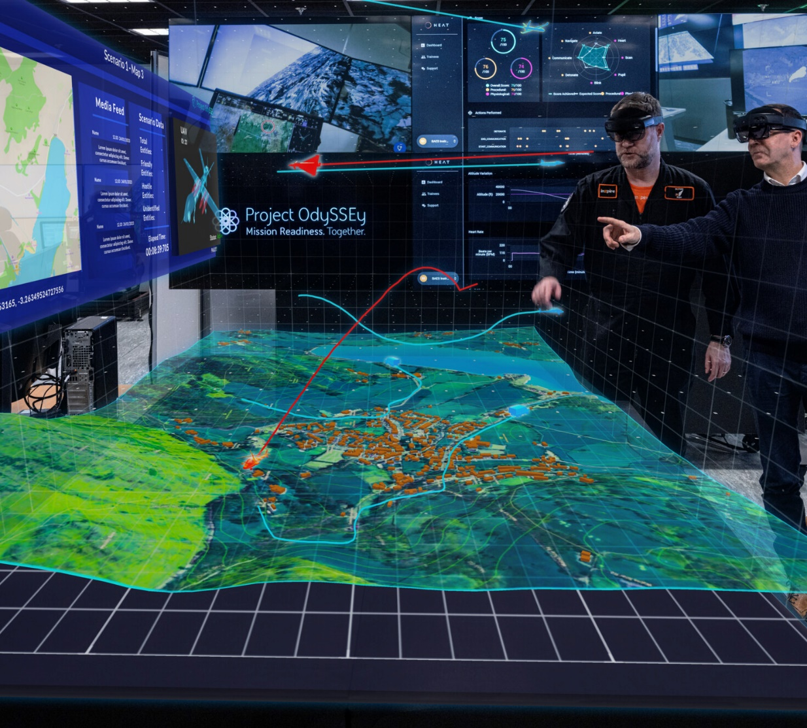
Hypothesis
Analysis Tasks Provide Opportunity:
To increase diversity, we need to provide opportunities and encourage the early careers community to engage in impactful projects.
This will help staff remain passionate about defence science, technology and analysis and bring diversity to the middle and senior research community of the future.

Slide 7
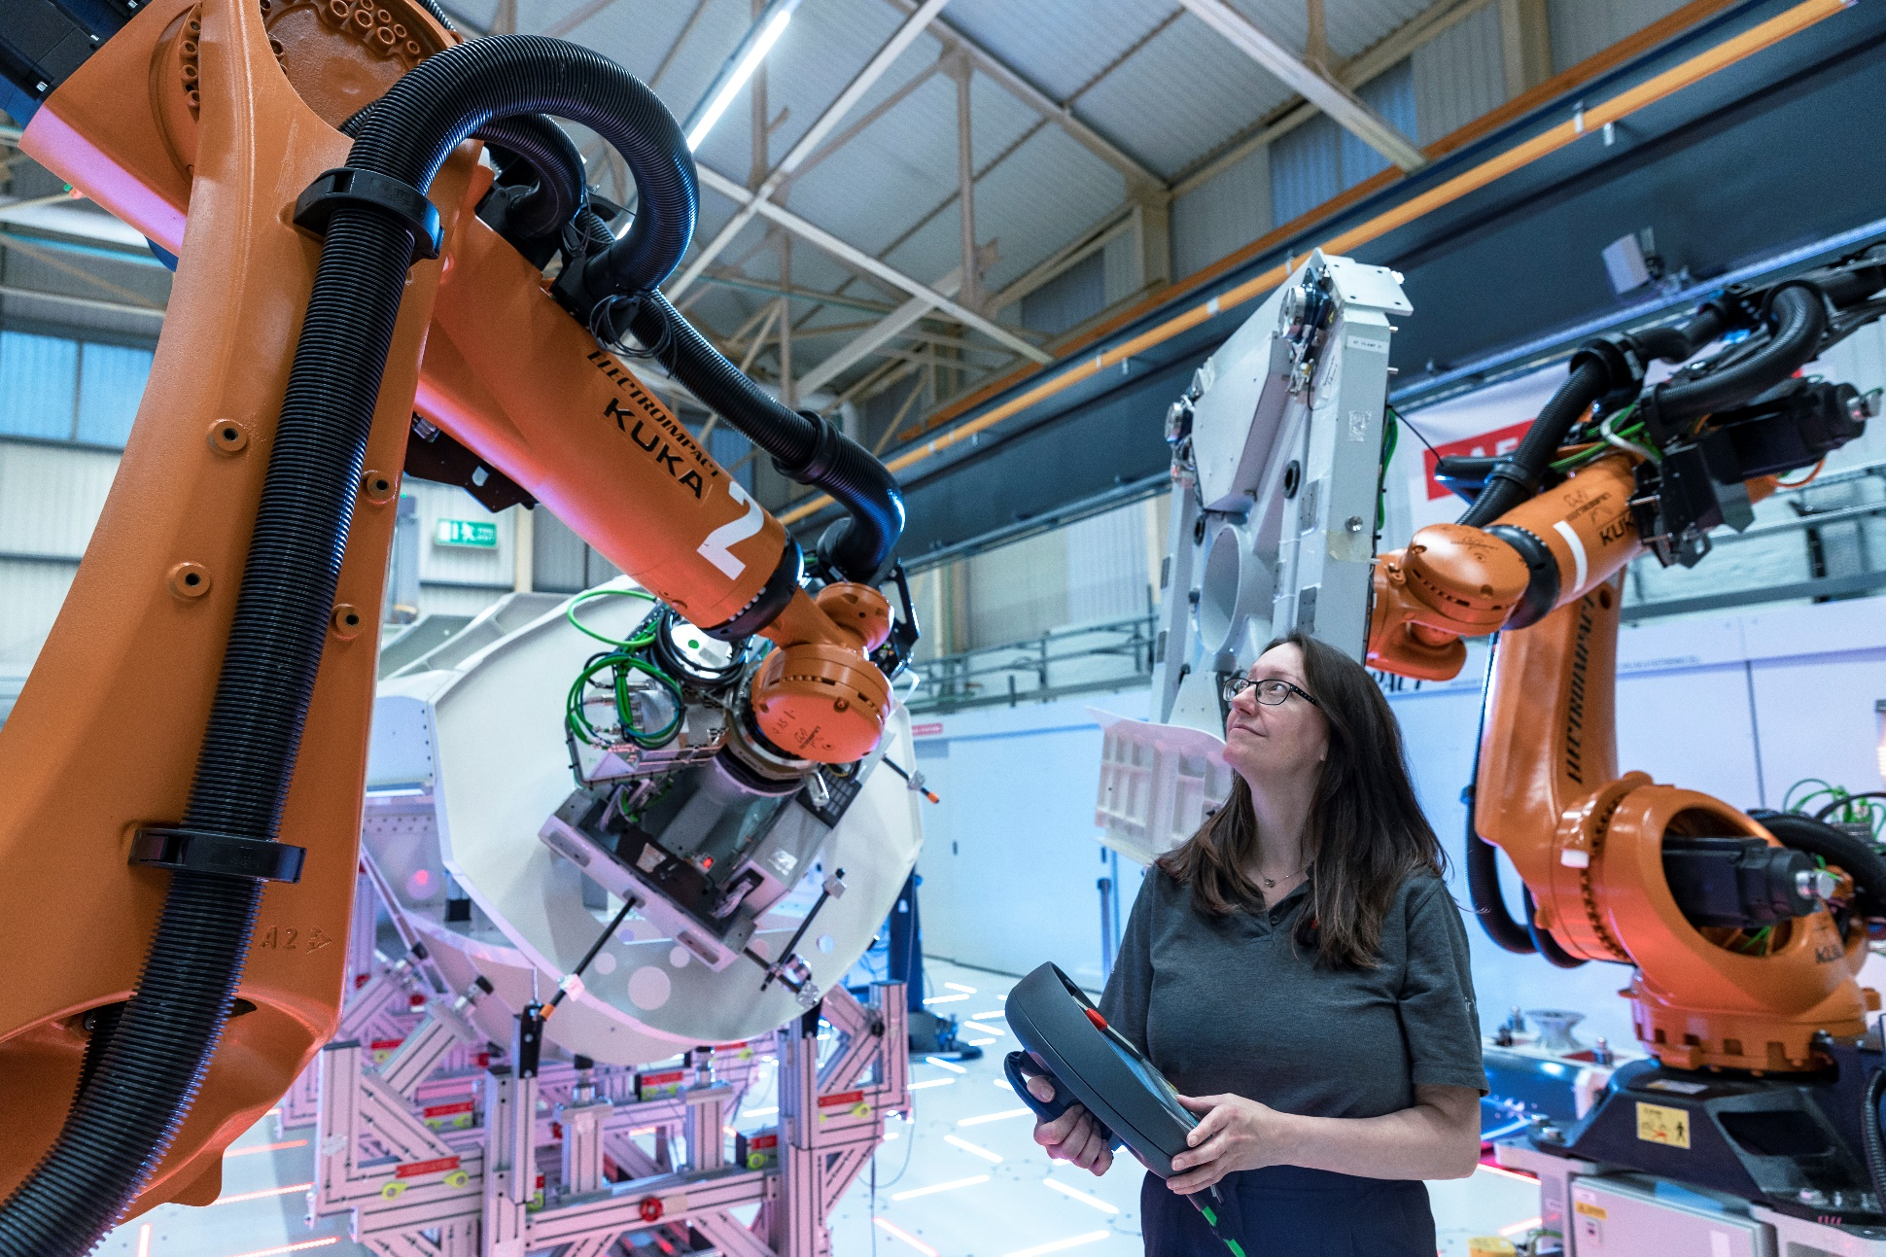
The Project – System Analysis
A competitively tendered study, funded by MOD.
Evaluation of an electromechanical system.
Scrutinise performance against claims in published literature.
Required a multi-disciplinary team.
Successfully delivered to time, cost and quality.

Slide 8

Analysis Case Study:
Led by experienced colleagues, delivered by early careers talent
6. Peter L
Materials Scientist
1. Andy S
Technical Lead
Peter graduated with a degree in theoretical physics joining a BAE Systems materials failure analysis team 6 years ago as a materials scientist after opting for a more practical career path.
Andy has spent 35 years in the defence industry, working as a design engineer and technical lead on a number of BAE Systems’ products. Andy takes a hands-on approach to problem solving and knowledge sharing and is passionate about developing others.
5. Katie H
Project Manager
Katie is an early careers scientist who specialises in defence analysis of electro-optics and feasibility studies into novel optical systems.
2. Peter M
Project Manager Support
4. Daniel F
RF Engineer
Peter is an experienced project manager having delivered a number of projects for ESA, Dstl and internal to BAE Systems.
Daniel joined BAE Systems as a graduate in 2020 working in the Antennas & Electromagnetics group. He is a keen hardware enthusiast with a particular passion for embedded, RF test & measurement
3. Other
Misc Technical Support Staff
Distribution of project hours

Slide 9

Lessons Learnt
Providing a safe and mentored environment for early careers staff and trusting them to apply their skills pays highly in the short and longer term.
Experienced staff can provide ad hoc coaching in the delivery of these tasks.
Balancing independent responsibility with support is key to allow for development and growth.
The contract value enabled a diverse team structure.
A diverse delivery team improved affordability.

Slide 10

Closing Messages
To buyers: healthy budgets help bring diversity to the community.
To Project Leads: involving Early Careers personnel in impactful projects brings long term benefits.
There is value for all of us in providing opportunities for our Early Careers communities and it makes measureable progress to securing diversity across the defence enterprise.

Slide 11
“The creative industries continue to be dominated by those from privileged backgrounds. Less than one in ten arts workers comes from lower socio-economic groups. That’s not just a diversity issue, that’s a creativity crisis, and it means that we’re missing out on powerful radical and essential perspectives.”
Chris Sonnex, Big Issue, Issue 1666.
QUESTIONS
we’re missing out on powerful radical and essential perspectives.
.

